Slide 1


BIKE DEKHO SALES ANALYSIS DASHBOARD-INSIGHTS & FINDINGS
Using Excel
Prepared by : Eshani Banik

Slide 2

EXECUTIVE SUMMARY
  Built an interactive Excel dashboard with slicers, KPIs, and dynamic charts
  Analyzed customer demographics, behavior, and regional performance
  Identified key buying patterns and conversion trends
  Extracted insights to support data-driven business decisions.

Slide 3
BUSINESS PROBLEM
  Identify which customers buy bikes.
  Understand influence of gender, age, income, and region.
  Analyze external factors like commute distance, marital status, children.
  Understand customer conversion rate.
  Help leadership with quick real-time insights.

Slide 4
METHODOLOGY
  Data Cleaning
  Data Processing
  Data Analysis
  Data Visualization

Slide 5

KPI CARDS OVERVIEW
  Total Customers: 1026
  Total Buyers: 495
  Conversion Rate: 48%
  Gender Split: Male 51%, Female 49%

Slide 6




BUYER VS NON-BUYER ANALYSIS
Using Donut Chart
  Buyers: 48%
  Non-Buyers: 52%

Slide 7
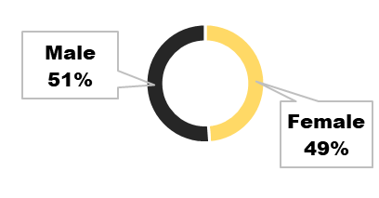
MALE VS FEMALE BUYERS
Using Donut Chart
  Male buyers: 51%
  Female buyers: 49%
Hence, Gender split is almost equal.

Slide 8
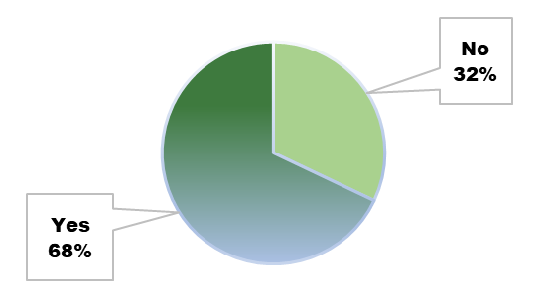
HOME OWNERSHIP VS PURCHASE
Using Pie Chart
  Homeowners buying: 68%
  Renters buying: 32%
Hence, Homeowners have more financial stability.

Slide 9
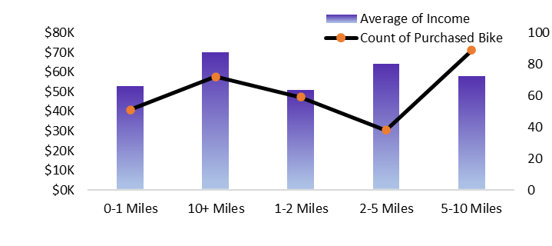
COMMUTE DISTANCE VS INCOME VS PURCHASE
Using Combo Chart
  Highest buyers are 0–1 miles commuters(in case of adult). and 5-10 miles (in case of seniors).
  Lowest bike purchase among 10+ miles commuters(in case of adult) and 2-5 miles(in case of senior).

Slide 10
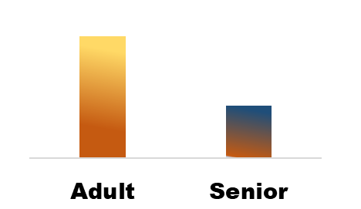
AGE GROUP VS BUYERS
Using Column Chart
  Adults (20–50) are the major buyers
  Seniors purchase significantly less.

Slide 11
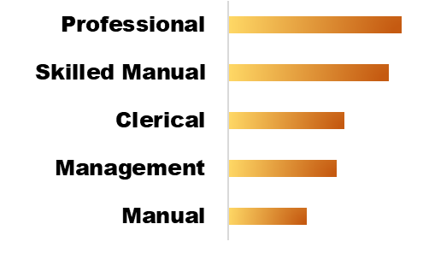
OCCUPATION VS BUYERS
Using Bar Chart
  Top buyers: Skilled Manual & Professional
  Lowest buyers: Manual labor
Hence, it Indicates bike purchases are linked to income stability

Slide 12
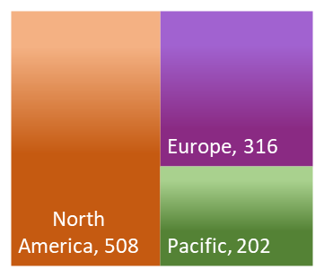
BUYERS ACROSS REGIONS
Using Tree map
  North America (508) → highest buyers
  Europe (316) → second
  Pacific (202) → lowest
Hence, Region heavily influences purchase behavior.

Slide 13

TOP 5 HIGH IMPACT FILTERS
influencing Bike Purchase
  Commute Distance
-Short-distance commuters are most likely to buy.
  Age Group
-Adults dominate purchases.
  Region
-North America & Europe drive the majority of sales.
  Income
-Higher income → higher purchase probability.
  Home Ownership
-Homeowners show strong purchase inclination (68%)

Slide 14


OVERALL INSIGHTS
for Stakeholders
  Adults are the key target group
  Gender split is balanced → both segments equally important
  Homeowners & high-income professionals are dominant buyers
  North America & Europe outperform Pacific region

Slide 15
BUSINESS RECOMMENDATIONS
  Focus marketing on Adults aged 20–50.
  Promote high-utility commute-friendly bikes .
  Increase presence in North America & Europe, boost Pacific with offers.
  Create occupation-based financing plans.
  Launch female-oriented campaigns.
  Offer premium models or loans to high-income & homeowners.
  Use demographic filters (cars, marital status, children) for micro-targeting.
.

Slide 16
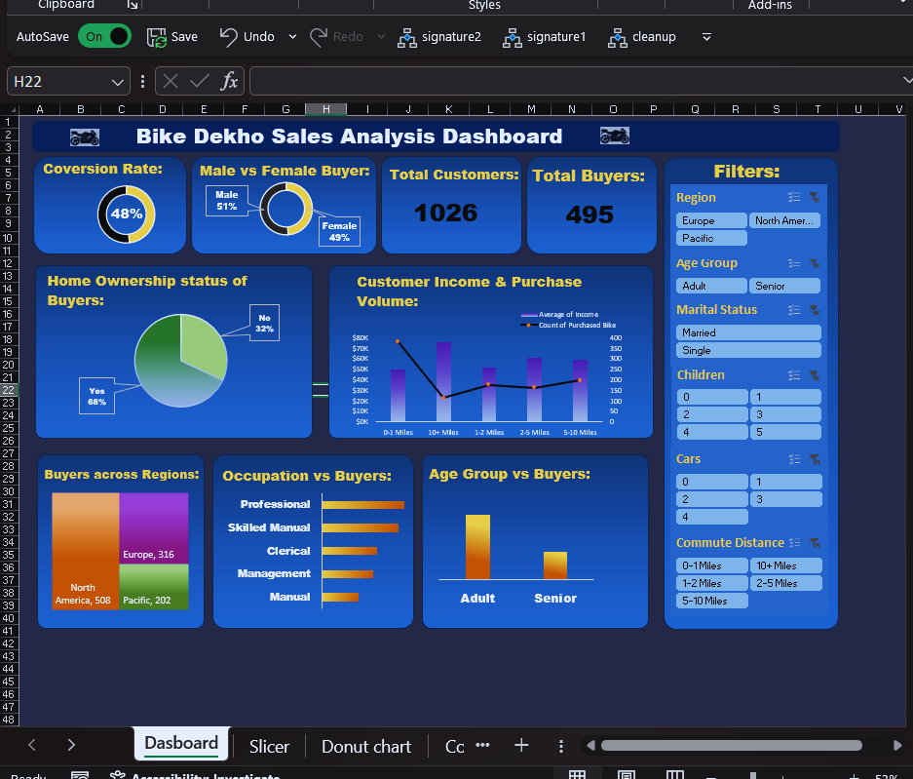
FINAL DASHBOARD

Slide 17

THANK YOU!!

